Slide 1
Bon Appétit
18WH1A1216 - Pravallika N
18WH1A1218 - Harshitha K
18WH1A1209 - Tanmayee B
18WH1A1235 - Ambica V
18WH1A1226 - Himabindu B
18WH1A1232 - Fareesa I
19WH5A1201 - Harika D
18WH1A1252 - Amrutha Ch

Slide 2
CONTENTS
→ Overview
→ Target Audience
→ Understanding the Problem Statement
→ Project Objective
→ UML Diagram
→ Cycle Diagram

Slide 3
OVERVIEW
The food distribution system approach helps orphanages to get in reach with the leftover food ( food not used ) coming from event managing organisations. These organisations pack the food which was not served and send them to orphanages. Through this we are making sure that the food is not wasted and no person is sleeps hungry.

Slide 4
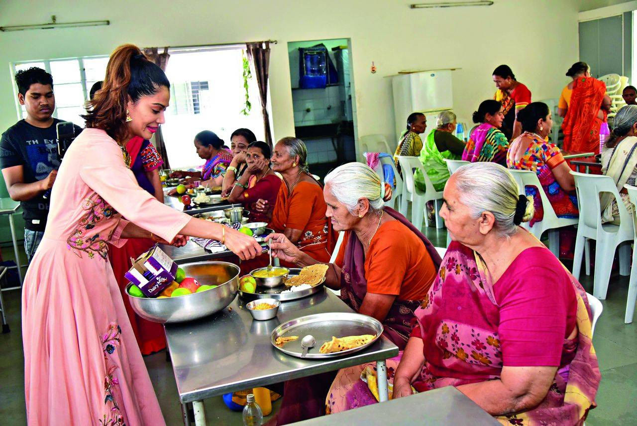
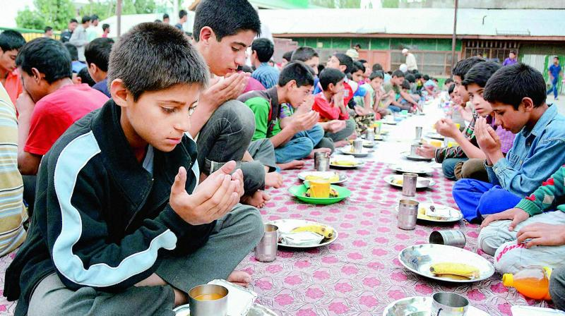
TARGET AUDIENCE
Orphanages
Old Age Homes
NGOs

Slide 5
UNDERSTANDING
THE PROBLEM
STATEMENT
01 The food distribution approaches
orphanage to get sufficient
food through event organizations
02
03 Modelling our software based on
the interfaces required
Listing the types of organizations where food is wasted.

Slide 6
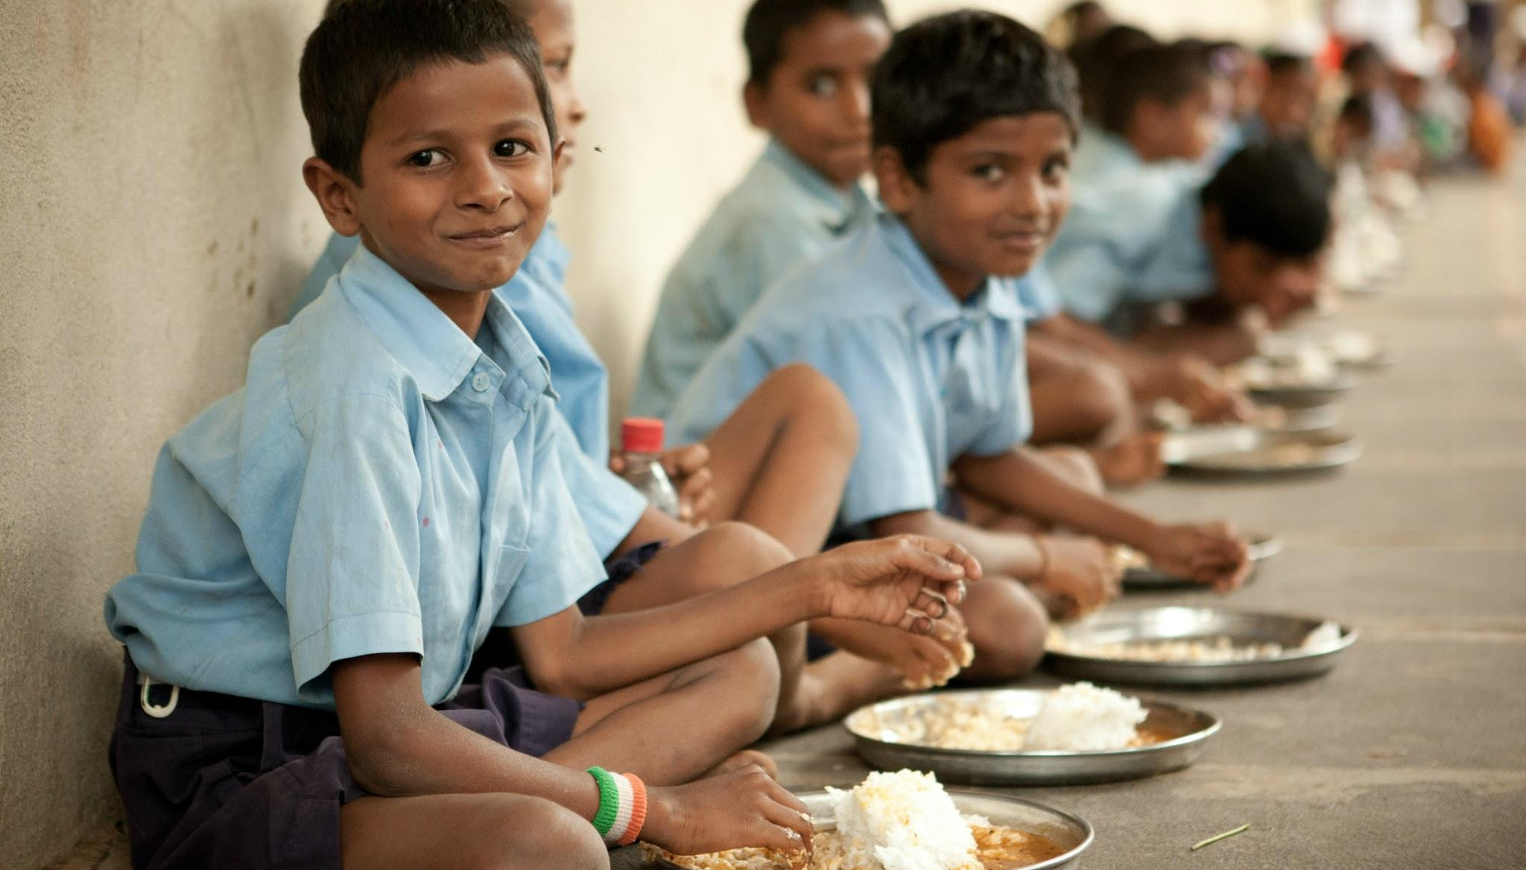
PROJECT OBJECTIVE
India is ranked at 102 on global hunger index, an index of 117 countries.
So a well-designed interface for the organisers to contact the orphanages in order to send food is a necessary need. We wish to help those in need of food and prevent food wastage at the same time.

Slide 7
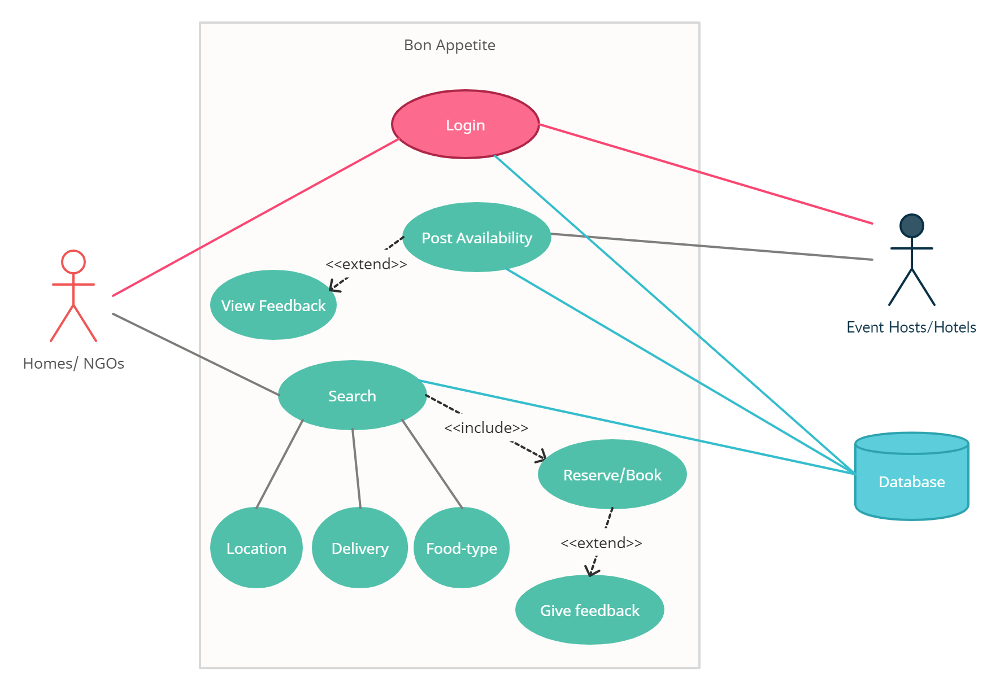

Slide 8
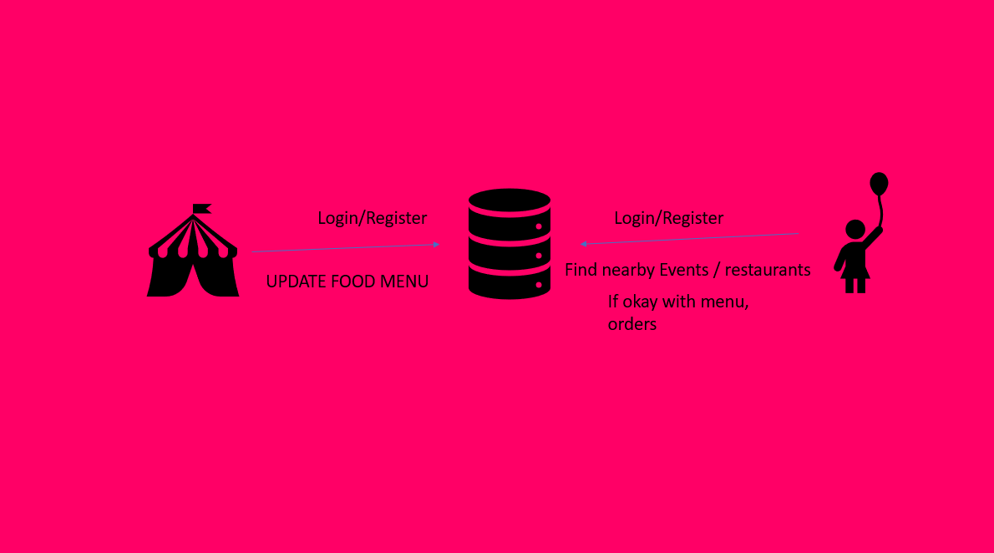
CYCLE DIAGRAM

